Slide 1




CUSTOMER SUPPORT ANALYSIS
A FRAMEWORK TO ANALYSING CUSTOMER SENTIMENT

Slide 2
INTRODUCTION
GOAL
To understand customer/user and customer support pairings and finding room for improvement
Does a certain polarity from a customer message influence the way customer support responds? Is there a correlation?
Can we obtain valuable information from emoji usage?
Is response time playing an important role?
CONTEXT & CHOSEN DATASET
Natural language remains the densest encoding of human experience we have
Innovation in NLP has accelerated to power understanding of this data
The Customer Support on Twitter dataset offers a large corpus of modern English conversations between consumers and customer support agents on Twitter

Slide 3

DATASET & Tools used
CONTENT
- Dataset of about 3 million tweets focusing around Customer Support queries and responses
- Columns of the dataset include the following information:
tweet_id: A unique, anonymized ID for the Tweet
author_id: A unique, anonymized user ID
Inbound: Whether the tweet is "inbound" to a company doing customer support on Twitter
created_at: Date and time when the tweet was sent
Text: Tweet content
response_tweet_id: IDs of tweets that are responses to this tweet, comma-separated
in_response_to_tweet_id: ID of the tweet this tweet is in response to, if any
TOOLS
Pre-processing text techniques (Stemming, Lemmatizing…)
NLTK, TextBlob, Statistics (Mean, Cov, Correlation – Pearson’s)
Notes:
The dataset is a CSV, where each row is a tweet. The different columns are described below. Every conversation included has at least one request from a consumer and at least one response from a company. Which user IDs are company user IDs can be calculated using the inbound field.

Slide 4



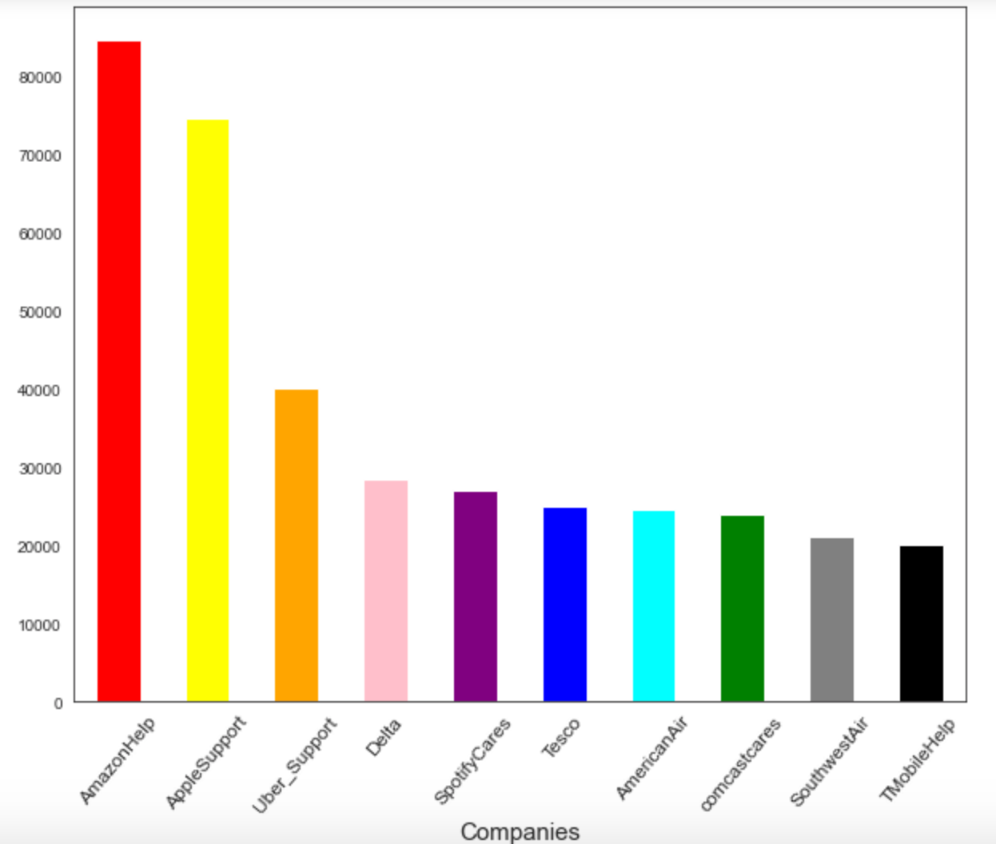

Let’s start exploring….
1
2
Tweets Volume per Company
3

Slide 5
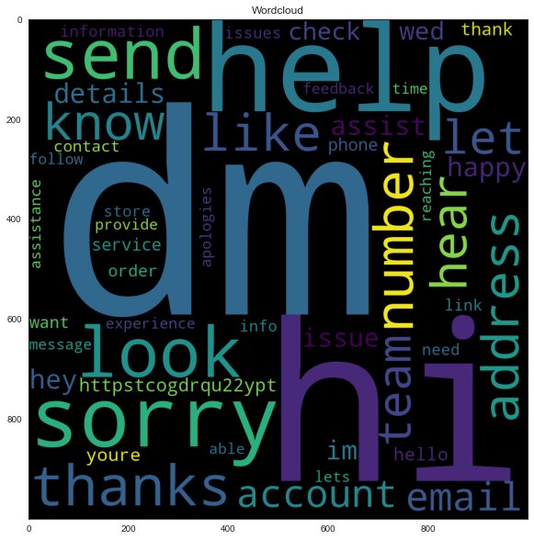
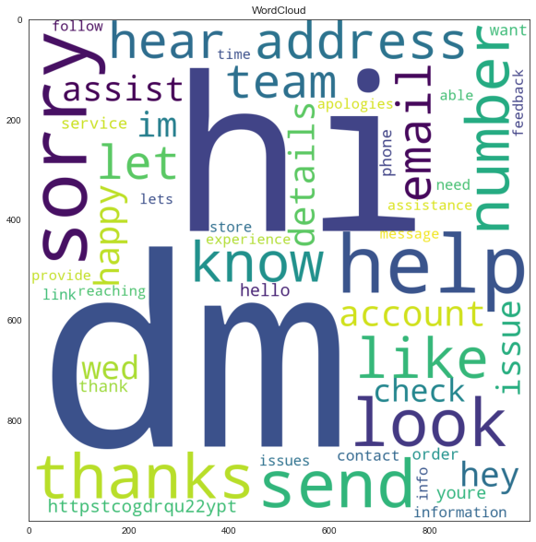
And what about most frequent words?
From Customer Support
From Customers

Slide 6
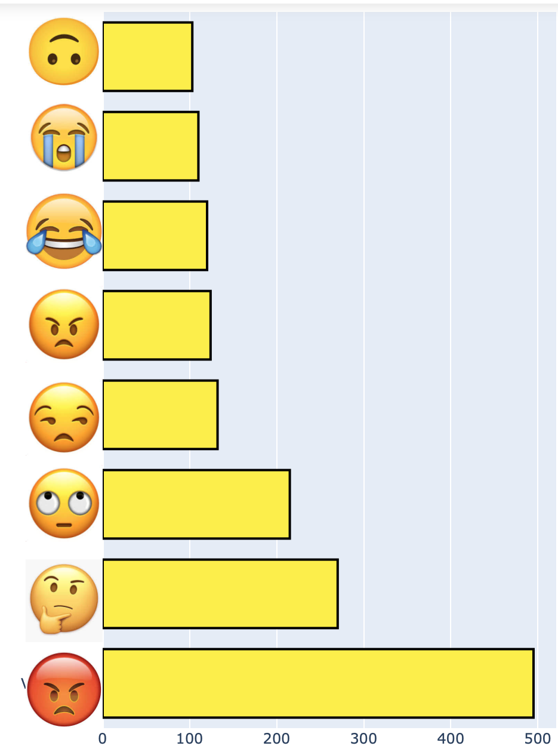
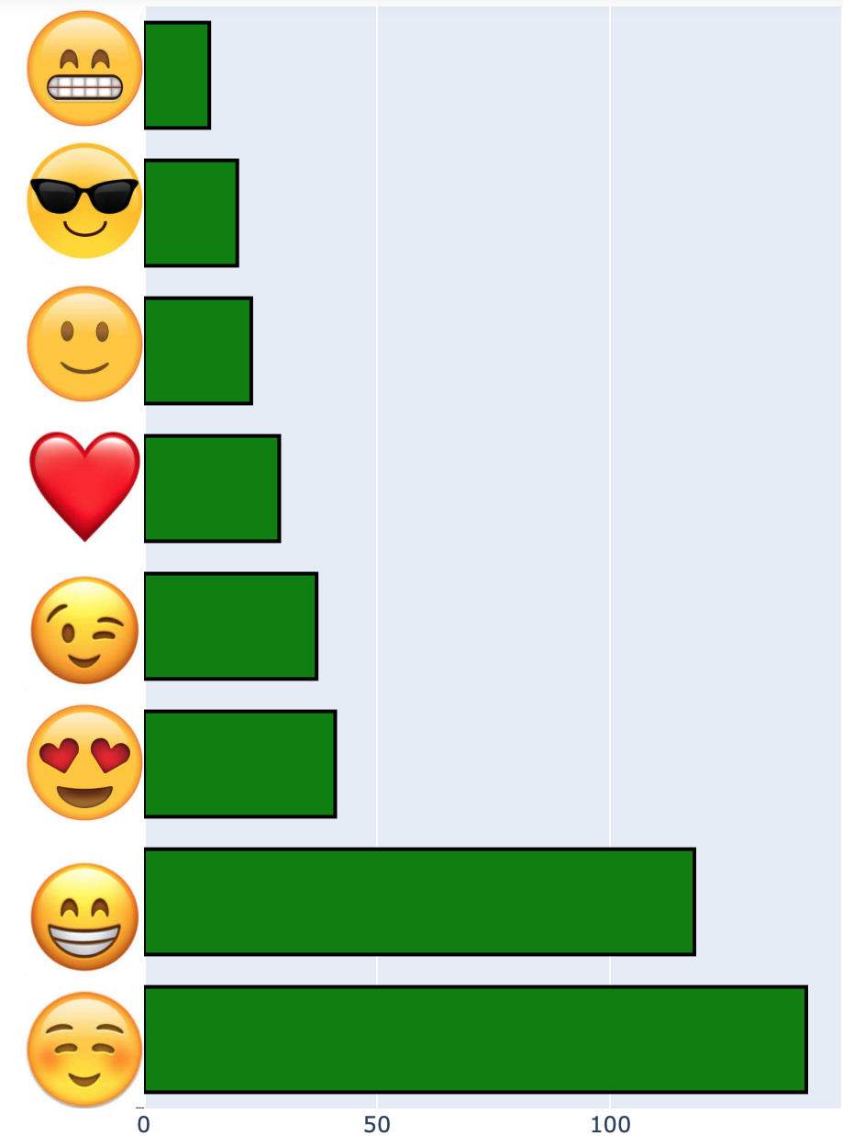
Emoji analysis: Amazon case
Top Customers Emojis
Top Customer Support Emojis
103
14
110
20
121
23
125
30
132
37
215
41
271
120
495
143

Slide 7
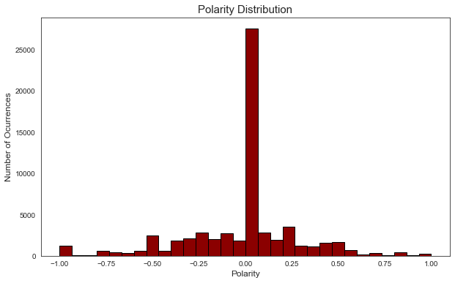
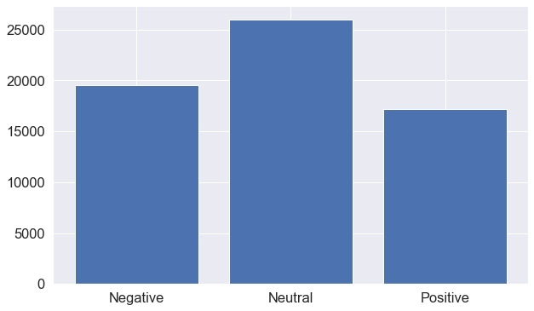



SUBJECTIVITY AND POLARITY: amazon case
Subjectivity: Means emotions expressed in a sentence, across a range of negative, to positive
Polarity: Subjective sentence expresses some personal feelings, views, or beliefs
31.0 %
31.0 %
27.5 %
Subjectivity
35. 6% of objective tweets

Slide 8
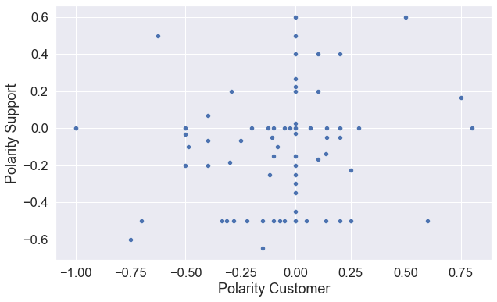
Relationship between Customer and Customer Support tweets: AMAZON CASE
Testing Correlation between Customer and Customer Support Polarity in Tweets
Covariance between polarities shows a positive result of 0.011 -> variables change in the same direction
Pearson’s correlation suggests positive correlation but not a very strong one (0.11)
What about the relationship between polarity and subjectivity?
Covariance between polarities shows a positive result of 0.08 -> variables change in the same direction
Pearson’s correlation suggests positive correlation -> strong one (0.67)

Slide 9
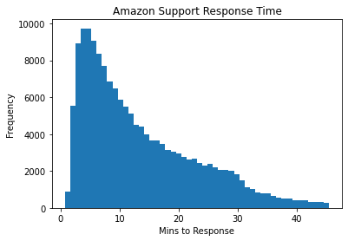
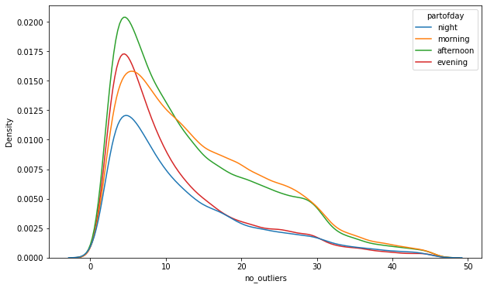
Time response analysis: amazon case
Amazon's average response time is 13.44 minutes.
Part of Day | Response Time
Afternoon | 13.69
Evening | 11.47
Morning | 14.94
Night | 12.65
Uber's average response time is 13.76 minutes.
Apple's average response time is 109.08 minutes.

Slide 10




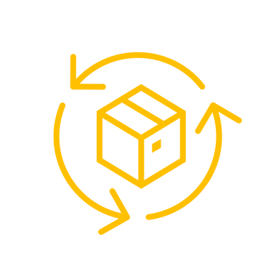
Conclusions & improvements
Customer Support addresses customer tweets always with positive emoticons/emojis while most customer queries included negative ones
There is a high degree of subjectivity in tweets (36% are objective)
Polarity in tweets is mainly neutral (according to polarity distribution)
There is no apparent correlation between customer support and customer’s polarity in tweets
There is a strong correlation between subjectivity and polarity -> the more strong feelings are expressed, the more the overall comment is subjective and vice versa
Amazon’s time response is efficient at any time of the day (around 14 minutes), surpassing Uber and Apple customer support response time
Improvements
What are customers’ main concerns and how can companies address them?
Trying out models to predict accurate successful outcomes
Investigating voice recordings (call centres) to measure customer satisfaction

Slide 11
Thank you for your attention
ANY QUESTIONS?

